Slide 1
36 Hour Study Sessions?
By Raunak Pednekar

Slide 2
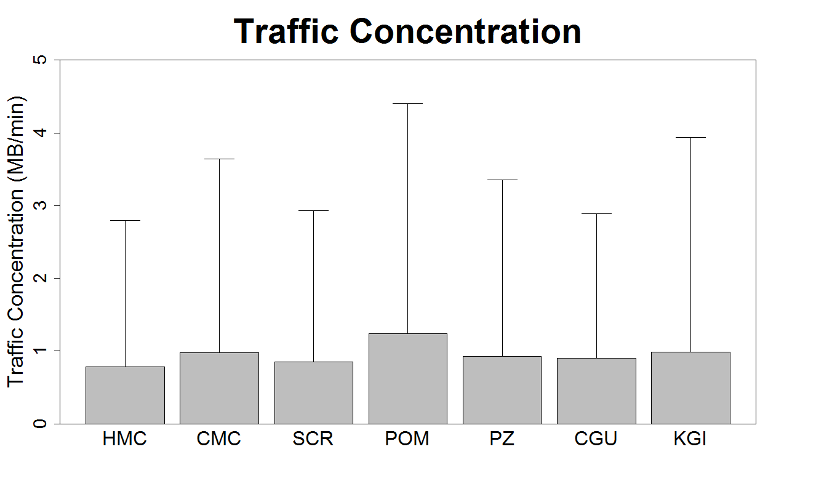
Traffic Concentration
Traffic Concentration = Megabytes Transferred/Number of Minutes

Slide 3
Do some people really connect with WiFi for over a day?

Slide 4
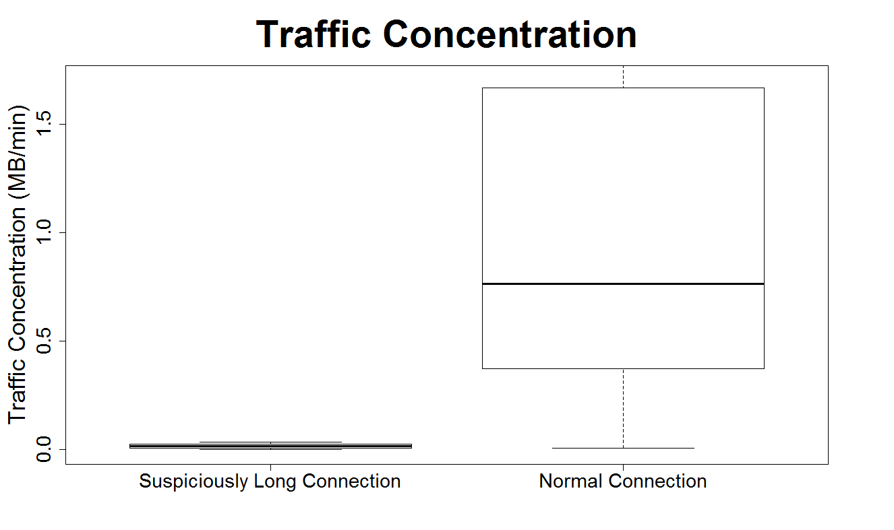
Do some people really connect with library WiFi for over a day?
Notes:
Underestimate
Mean not median
Outliers
t.test

Slide 5
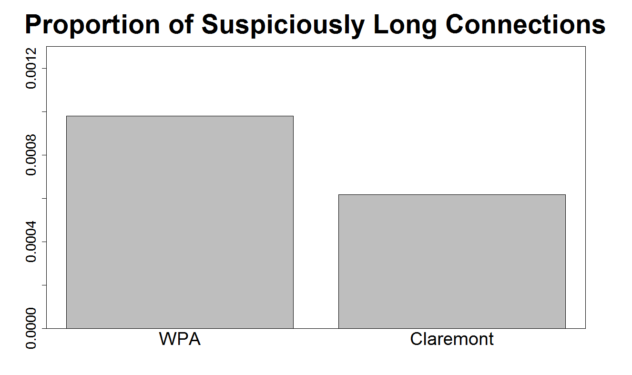
WiFi Network?

Slide 6
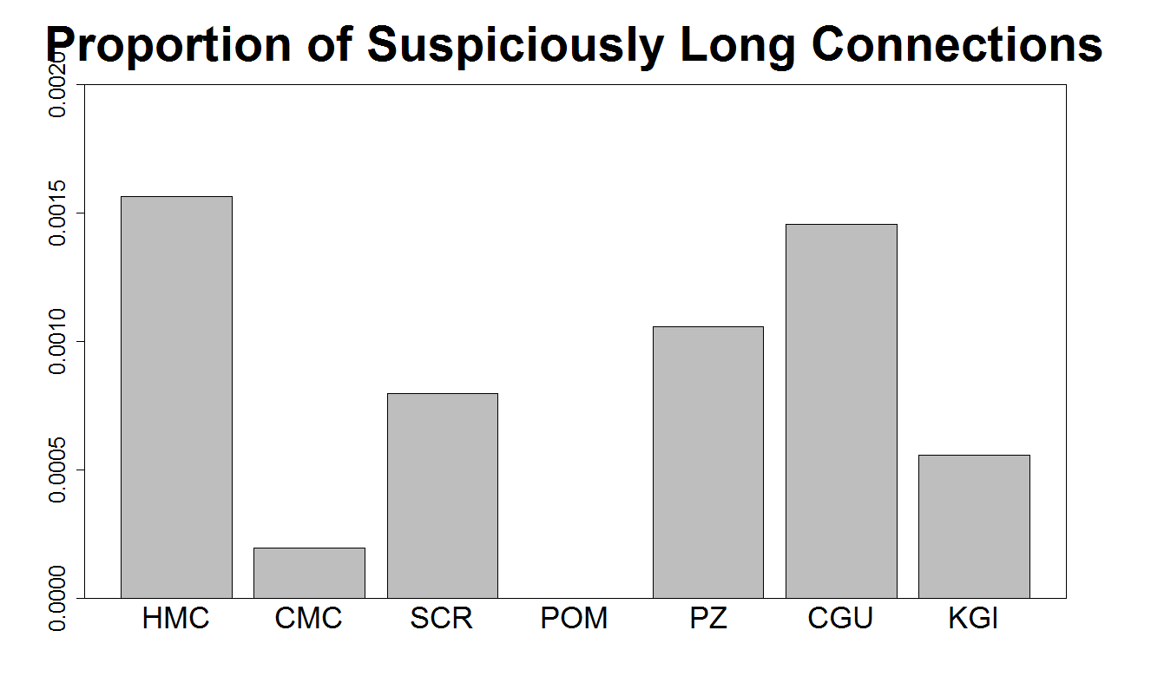
School?

Slide 7
Conclusions
WiFi connections lasting over a day are almost certainly false (~0.1% of all data)
False data doesn’t seem to be related to WiFi network (WPA/Claremont)
Pomona devices never give false data!?!

